Slide 1
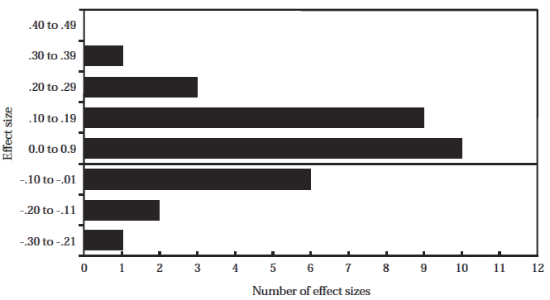
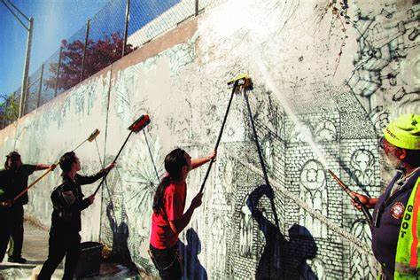
Restorative Justice the Alternative to Juvenile Detention
Kynnedee Mayhew
Faculty Sponsor Professor Shelley Grant
Jacksonville University, Jacksonville, FL, USA
History of Juvenile Delinquency
Results
In our history, juvenile detention has been the preventative measure for stopping crime produced by our youth in America. Every day in America, approximately 2,500 children are arrested. Of these, nearly 70% are Black or Latino (ACLU, 2023). Trapped, stuck, and bound in an interminable cycle, research shows that 70 to 80% of incarcerated juveniles will be rearrested within 3 years of release (DOJ, 2023). Harsher consequences were set in place for the youth to de-escalate the apprehension of Americans toward the youth. This not only worsened the issue but also increased the recidivism rates of juvenile offenders, eventually depleting the public’s trust in the criminal justice system (NIH, 2021). This study has led me to one question: What can be an alternative to juvenile detention for nonviolent felony offenses to minimize the likelihood of recidivism and maximize the public's trust in the criminal justice system?
Restorative Justice is an alternative approach to crime and conflict that focuses on the reparation of harm rather than the punishment of offenders (Fulham, Blais, Schultheis, 2023). Restorative Justice is an alternative to juvenile detention for nonviolent felony offenses, minimizing the likelihood of recidivism and maximizing the public’s trust in the criminal justice system. With the various ways restorative justice can be implemented within the juvenile justice system, the most effective ways that would foster a significant change within the system is through victim-offender mediation, monetary and service reparations, and community integration. With these three practices of restorative justice being applied instead of juvenile detention, healing is promoted for not only victims and offenders but for the various communities.
Government of Canada, “Distribution of Effect Size Estimates (RECIDIVISM)”,2022.
Findings
Every day in America, approximately 2,500 children are arrested. Trapped, stuck, and bound in an interminable cycle, research shows that 70 to 80% of incarcerated juveniles will be rearrested within 3 years of release. (DOJ, 2023). The various qualitative research studies used to develop this alternative examine how effective RJ programs are for youth in reducing future delinquent behavior, which potentially results in lower recidivism rates (Umbreit & Armour, 2011).
Based on the findings of this meta-analysis, restorative justice programs are a more effective method of improving victim-offender satisfaction, increasing offender compliance with restitution, and decreasing the recidivism of offenders when compared to more traditional criminal justice responses (i.e. incarceration, probation, court-ordered restitution).(Department of Justice, Electronic Comm., 2022b).
Conclusions
Restorative justice as an alternative to juvenile detention is a way to right the wrongs of the harsh treatment of the youth in our criminal justice system, which has been an ongoing issue for decades. RJ is a way to address the causes and effects of crime, not by punishment but through effective and suitable ways to promote healing victims, offenders, and communities. This then maximizes the public’s trust in the criminal justice system, creating the foundation of a functioning, effective, and secure society.
Significance
From ‘tough on crime’ policies to the ‘Just Say No’ movement to the ‘Super Predator’ prediction, Americans have feared the youth and the safety of children and adults amongst the societies within the American states (Trueblood, 2021). This moral panic, starting in the 1950s, has led to the over-penalization of juvenile delinquents (Barnosky, 2006). This prevalent issue has continued to disproportionately affect the youth who fit into the stereotype of the “average juvenile delinquent” person, who are often incarcerated for nonviolent felony offenses. Media sensationalism and government warnings created and maintained the system of discriminatory punishment based on stereotypes of juvenile delinquency (Trueblood, 2021).
References
Kimbrell, C. S., Wilson, D. B., & Olaghere, A. (2023). Restorative justice programs and practices in juvenile justice: An updated systematic review and meta‐analysis for effectiveness. Criminology & Public Policy, 22(1), 161–195.
Chambers, Dustin. “The removal of gray paint from ‘Roti’ Mural”. Research Gate, Atlanta, GA. 2012. https://www.researchgate.net/publication.
Children’s Defense Fund. “Youth Justice Children’s Defense Fund.” Children’s Defense Fund, 28 Oct. 2024, www.childrensdefense.org/tools-and-resources/the-state-of-americas-children/soac-youth-justice.
Mark S. Umbreit. (n.d.-b). Retrieved from https://www.westerncriminology.org/
Government of Canada, Department of Justice, Electronic Communications. (2022, August 26). The Effectiveness of Restorative Justice Practices: A Meta-Analysis. Retrieved from https://www.justice.gc.ca/
Dustin Chambers, “The removal of gray paint from "Roti" Mural”, 2012. Atlanta, GA. 2012.

